Slide 1
Research Proposal Presentation
Securing the Future: Cybersecurity in IoT for the Construction Industry

Slide 2

The Importance of IoT in Construction
1 – Efficiency
Real-time monitoring and data analytics optimize resource allocation and streamline processes.
Predictive maintenance reduces equipment downtime and operational costs.
Automation enhances workflows and minimizes human error.
2 - Safety
Smart sensors and wearables detect potential hazards, preventing accidents
Real-time location tracking ensures worker safety in dangerous areas
Automated systems minimize human exposure to high-risk tasks.
3 – Productivity
Remote monitoring and control enable faster decision-making and problem-solving
Connected devices and equipment facilitate seamless collaboration among stakeholders
Data-driven insights help optimize project timelines and resource utilization.
The adoption of IoT in construction is driving the industry towards Construction 4.0, integrating digital technologies for enhanced operational efficiency, collaboration, and sustainability (Statsenko et al., 2022)
Notes:
This slide highlights the three key areas where IoT is making a significant impact in the construction industry. It provides specific examples of how IoT technologies are improving efficiency, safety, and productivity, emphasizing the transformative potential of IoT in driving the industry towards Construction 4.0.

Slide 3
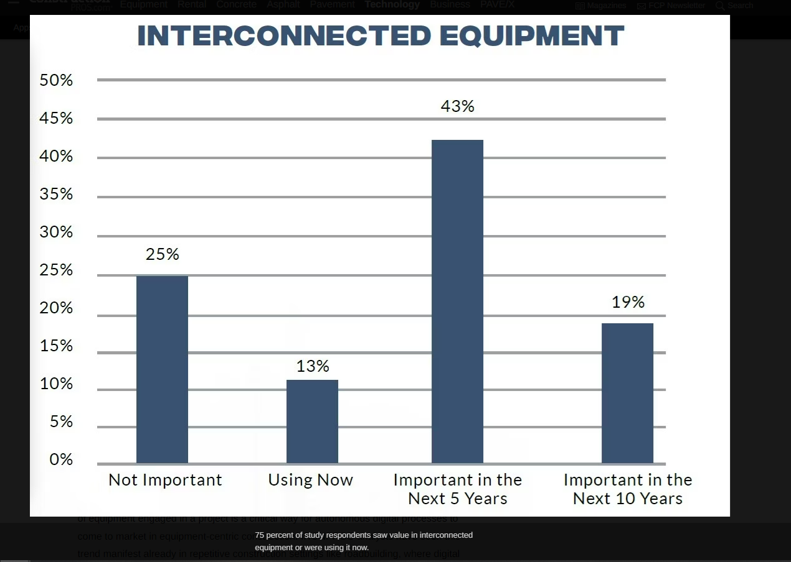
The Importance of IoT in Construction
Technologies like AI, IoT, AR/VR, and interconnected equipment have a transformative impact on the construction industry.
These technologies are expected to bring about significant changes in construction, just as they have done in other industries.
These technologies are being adopted and integrated into the construction workflow.
It highlights the potential of these technologies to enhance efficiency and drive innovation in the construction sector.
(Rathmann, 2023)

Slide 4
Cybersecurity threats in construction IOT
As the construction industry increasingly adopts IoT technologies, the expanded attack surface gives rise to significant cybersecurity threats
Threats:
Unauthorized Access and Data Breaches
Malware and Ransomware Attacks
Insider Threats and Human Errors
The consequences of these threats can be severe:
Financial Losses
Reputational Damage
Compromised Safety
Notes:
Sensitive project data and intellectual property at risk - Potential for theft of financial information and employee records.
IoT devices as entry points for malware infiltration - Ransomware attacks can halt operations and lead to substantial financial losses.
Inadvertent or malicious actions by employees can compromise security - Lack of cybersecurity awareness and training exacerbates risks
Consequences:
Cyber incidents can result in significant costs for remediation, legal fees, and lost productivity.
Security breaches can erode trust among clients, partners, and the public, harming the company's brand.
Hacked IoT devices and systems can endanger worker safety on construction sites
This highlights the importance of addressing cybersecurity risks to ensure the successful and safe implementation of IoT in the construction industry.

Slide 5
Current Lack of Comprehensive Research and Strategies
The integration of IoT in the construction industry brings numerous benefits, but it also security challenges.
Despite the growing adoption of IoT in construction, there is a lack of comprehensive research and strategies specifically addressing construction IoT security.
Limited understanding of construction IoT security
Lack of comprehensive threat analysis
Inadequate security frameworks and best practices
Minimal focus on risk mitigation strategies
(Bayram et al., 2023; Almaiah and Lutfi, 2023; IoT For All, 2023)
Notes:
Due to its unique characteristics, such as dynamic project environments and various stakeholders, construction IoT security requires tailored approaches. However, the current research landscape lacks in-depth studies focusing specifically on construction IoT security challenges and solutions.
The construction industry faces specific cybersecurity threats related to IoT adoption, including unauthorized access, data breaches, and manipulation of connected devices. However, limited research has been conducted to comprehensively analyse these threats and understand their potential impact on construction projects.
Existing IoT security frameworks and best practices are often generic and do not address the specific needs and challenges of the construction industry. Lack of industry-specific guidelines and standards hinders the development and implementation of effective security strategies in construction IoT projects.
Scarcity of research focusing on practical risk mitigation strategies for construction IoT projects. Proactive measures, such as secure device provisioning, secure communication protocols, and regular vulnerability assessments, are vital but not adequately explored in the current literature.

Slide 6
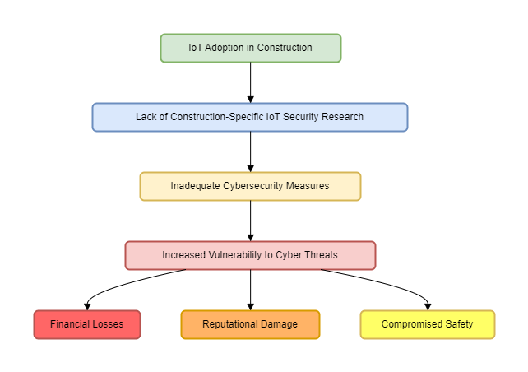
Notes:
The flowchart illustrates the potential consequences of the current security gap, showing how the lack of construction specific IoT security research can lead to inadequate cybersecurity measures, increased vulnerability to cyber threats, and ultimately result in financial losses, reputational damage, and compromised safety.

Slide 7

Research Question: "What are the effective strategies to mitigate cybersecurity risks in IoT applications within the construction industry?"
Notes:
Our research question focuses on identifying effective strategies to mitigate cybersecurity risks in IoT applications within the construction industry. This is a critical area of study as the integration of IoT in construction processes increases, bringing along potential cybersecurity threats. Our goal is to understand these risks and propose strategies to mitigate them, ensuring secure and efficient use of IoT in the construction industry.
Addressing this research question will contribute to enhancing the security and resilience of IoT systems in the construction industry - Facilitating the safe and successful adoption of IoT technologies in construction projects - Promoting industry-wide awareness and collaboration in tackling cybersecurity challenges

Slide 8
Cybersecurity threats and challenges specific to IoT in the construction industry.
This research aims to investigate and pinpoint the most significant cybersecurity threats and challenges that are unique to the adoption of Internet of Things (IoT) technologies in the construction industry
Unauthorized access and data breaches
Malware and ransomware attacks
Insider Threats and Human Errors
Technical and organisational challenges
Notes:
Unauthorized access and data breaches:
Examine the potential for unauthorized parties to gain access to sensitive construction data. Assess the risks and consequences of data breaches in the context of construction IoT.
Malware and ransomware attacks:
Investigate the vulnerability of construction IoT systems to malware and ransomware attacks. Analyse the potential impact of such attacks on construction operations and project timelines.
Insider threats and human errors:
Evaluate the risks posed by insider threats, such as disgruntled employees or unintentional errors. Examine the role of human factors in compromising the security of construction IoT systems
Technical and organisational challenges:
Identify the technical challenges in securing construction IoT, such as device discrepancy and resource constraints. Assess organizational barriers, including lack of cybersecurity awareness and training among construction professionals

Slide 9

Methodology: Literature Review, Framework Analysis, and Mitigation Strategies
Key literature to be reviewed and the list is not exhaustive:
Alshammari et al. (2021) - Cybersecurity for digital twins in the built environment.
Mantha et al. (2021) - Cybersecurity threat modelling in the AEC industry.
Tanga et al. (2022) – Cyber-attack risks to construction data management in the Industry 4.0 era.
Abie (2019) - Cognitive cybersecurity for IoT-enabled healthcare ecosystems.
Alladi et al. (2020) - Industrial IoT security framework for smart waste management.
- Kanan et al. (2018) - Cybersecurity challenges and solutions for IoT-based smart grids.

Slide 10
Methodology: Literature Review, Framework Analysis, and Mitigation Strategies
Cybersecurity Framework Analysis:
Examine existing cybersecurity frameworks and their applicability to construction IoT
Evaluate the strengths and limitations of frameworks such as NIST, ISO 27001, and IEC 62443.
Adapt and extend relevant frameworks to address the specific needs of construction IoT security.

Slide 11
Methodology: Literature Review, Framework Analysis, and Mitigation Strategies
Mitigation Strategy Proposal:
Develop a multi-layered approach to mitigate cybersecurity risks in construction IoT.
Propose technical solutions, such as blockchain-based authentication and anomaly detection.
Suggest policy and regulatory interventions, like mandating security standards for IoT devices.
Recommend organizational measures, including third-party risk management and incident response
Notes:
This research will propose a comprehensive set of mitigation strategies tailored to the unique cybersecurity challenges faced by the construction industry in the era of IoT. The literature review section emphasises the focus on studies published that address cybersecurity threats, challenges, and solutions specific to construction IoT. It highlights key literature to be reviewed, including recent works by Alshammari et al. (2021), Mantha et al. (2021), and Tanga et al. (2022).
The cybersecurity framework analysis section discusses the examination of existing frameworks, such as NIST, ISO 27001, and IEC 62443, and their applicability to construction IoT. It emphasizes the need to adapt and extend these frameworks to address the specific security requirements of the construction industry.
The mitigation strategy proposal section outlines the development of a multi-layered approach to mitigate cybersecurity risks in construction IoT. It includes proposing technical solutions, recommending organizational measures, and suggesting policy and regulatory interventions.

Slide 12
Key Findings from Existing Research:
Unauthorized access and data breaches. Construction IoT systems are vulnerable to unauthorized access due to weak authentication mechanisms (Tanga et al., 2022). Data breaches can expose sensitive information, such as building plans and employee records (Parn & Edwards, 2019). Implementing strong access control measures, like multi-factor authentication, is crucial (Alshammari et al., 2021).
Malware and Ransomware Attacks: IoT devices in construction are susceptible to malware infections, disrupting operations (Mantha & García de Soto, 2019). Ransomware attacks can encrypt critical data, leading to project delays and financial losses (Tanga et al., 2022). Regular security updates and employee training are essential to mitigate malware risks (Kanan et al., 2018).

Slide 13
Key Findings from Existing Research
Need for Robust Encryption and Security Protocols: Encrypting data at rest and in transit is vital to protect sensitive information in construction IoT (Alladi et al., 2020)Secure communication protocols, like TLS and DTLS, are necessary to prevent eavesdropping and tampering (Abie, 2019). Lightweight encryption algorithms, such as AES and ECC, are suitable for resource-constrained IoT devices (Alshammari et al., 2021).
Addressing these findings requires:
- Implementing strong authentication and access control measures
- Regularly updating software and firmware to patch vulnerabilities
- Encrypting sensitive data and using secure communication protocols
- Providing cybersecurity training to construction professionals
Notes:
This slide summarizes the key findings from existing research on unauthorized access, malware attacks, and the need for robust encryption and security protocols in the context of construction IoT.
The section on unauthorized access and data breaches highlights the vulnerability of construction IoT systems due to weak authentication mechanisms, the potential exposure of sensitive information, and the importance of implementing strong access control measures.
The malware and ransomware attacks section discusses the susceptibility of IoT devices in construction to malware infections, the consequences of ransomware attacks, and the importance of regular security updates and employee training.
The need for robust encryption and security protocols section emphasizes the importance of encrypting data at rest and in transit, using secure communication protocols, and adopting lightweight encryption algorithms suitable for resource-constrained IoT devices.

Slide 14
Mixed-methods approach: Expert interviews and security practices surveys
Qualitative Data: Expert interviews
Conduct semi-structured interviews with cybersecurity experts and construction industry professionals
Gain insights into the perceived cybersecurity threats, challenges, and best practices in construction IoT.
Analyse interview data using thematic analysis to identify common themes and patterns
Sample questions:
What are the most significant cybersecurity risks faced by construction IoT systems?
How can construction organizations effectively mitigate these risks?
What are the main barriers to implementing robust cybersecurity measures in construction IoT?
Notes:
This slides outlines a mixed-methods approach that combines qualitative data from expert interviews and quantitative data from surveys to assess current security practices in construction IoT.
The qualitative data section discusses conducting semi-structured interviews with cybersecurity experts and construction industry professionals to gain insights into perceived cybersecurity threats, challenges, and best practices. It mentions using thematic analysis to identify common themes and patterns and provides sample interview questions.

Slide 15
Mixed-methods approach: Expert interviews and security practices surveys
Quantitative Data: Security practices surveys
Develop a survey questionnaire to assess current cybersecurity practices in construction organizations
Distribute the survey to a representative sample of construction professionals involved in IoT projects
Collect data on the adoption of security measures, such as encryption, access control, and incident response plans.
Analyse survey data using descriptive and inferential statistics to identify trends and correlations.
Sample survey items:
Does your organization have a dedicated cybersecurity team for IoT projects? (Yes/No)
How frequently does your organization conduct cybersecurity training for employees? (Likert scale)
Which of the following security measures are implemented in your IoT systems? (Multiple choice)
Notes:
This slide outlines a mixed-methods approach that combines qualitative data from expert interviews and quantitative data from surveys to assess current security practices in construction IoT.
The quantitative data section describes developing a survey questionnaire to assess current cybersecurity practices in construction organizations. It outlines the process of distributing the survey, collecting data on the adoption of security measures, and analysing the data using descriptive and inferential statistics. Sample survey items are provided to illustrate the types of questions that will be asked.
Integrating qualitative and quantitative data will provide a more nuanced understanding of the current state of cybersecurity in construction IoT and help identify targeted recommendations for improvement.

Slide 16
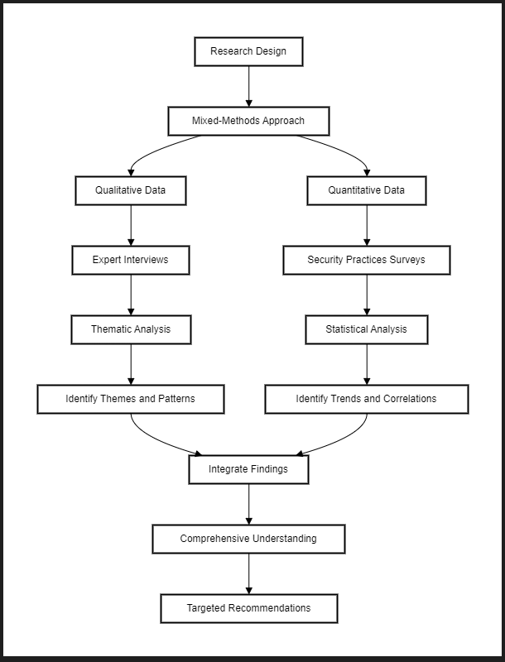
This diagram illustrates the research design using a mixed-methods approach, which combines qualitative and quantitative data collection and analysis
Notes:
By visually representing the research design, this diagram clearly communicates the flow of the mixed-methods approach, from data collection to analysis and integration, ultimately leading to targeted recommendations based on a comprehensive understanding of the subject matter.

Slide 17
Ethical considerations: Handling sensitive data and confidentiality
Informed Consent
Data Anonymization and Confidentiality
Secure Data Storage and Access
Compliance with Data Protection Regulations
Notes:
All participants will be provided with a clear and comprehensive informed consent form. The form will outline the purpose of the study, data collection methods, and potential risks and benefits. Participants will have the right to withdraw from the study at any time without consequence.
All collected data will be anonymized to protect the identity of participants and their organizations- Pseudonyms or unique identification numbers will be used in place of names or other identifying information - Confidentiality will be maintained throughout the data collection, analysis, and reporting processes.
Collected data will be stored on encrypted devices and password-protected cloud storage - Access to the data will be limited to the research team and granted on a need-to-know basis- Data will be securely destroyed after the completion of the research and dissemination of findings.
The research will adhere to relevant data protection regulations, such as the General Data Protection Regulation (GDPR) and the Health Insurance Portability and Accountability Act (HIPAA) - Appropriate technical and organizational measures will be implemented to ensure data security and privacy.
By prioritizing the ethical handling of sensitive data and maintaining confidentiality, this research aims to protect the rights and privacy of participants while contributing to the advancement of cybersecurity knowledge in the construction IoT domain.

Slide 18
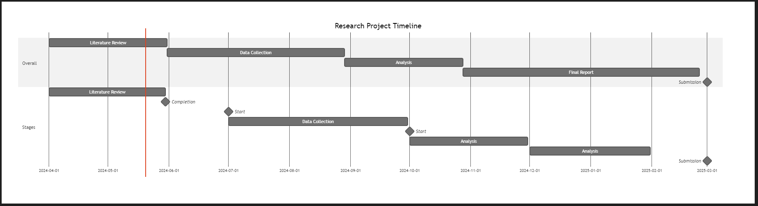
Research project timeline
The visual representation of the timeline provides a clear overview of the project's phases, their durations, and the key milestones. This can help in planning, tracking progress, and communicating the project schedule.
Notes:
The chart is divided into two sections: "Overall" and "Stages." The "Overall" section provides a high-level view of the main project phases, including Literature Review, Data Collection, Analysis, and Final Report.
The "Stages" section breaks down each phase into more specific tasks and milestones.

Slide 19
References
Abie, H. (2019). Cognitive cybersecurity for CPS-IoT enabled healthcare ecosystems. In Proceedings of the 13th International Symposium on Medical Information and Communication Technology (ISMICT) (pp. 1-6). IEEE. https://doi.org/10.1109/ISMICT.2019.8743670
Alladi, T., Chamola, V., Parizi, R. M., & Choo, K. K. R. (2020). Blockchain applications for industry 4.0 and industrial IoT: A review. IEEE Access, 7, 176935-176951. https://doi.org/10.1109/ACCESS.2019.2956748
Almaiah, M. A., & Lutfi, A. (2023). Cybersecurity Risk Analysis in the IoT: A Systematic Review. Electronics, 12(18), 3958. Available at: https://www.mdpi.com/2079-9292/12/18/3958
Alshammari, K., Beach, T. and Rezgui, Y., 2021. Cybersecurity for digital twins in the built environment: current research and future directions. Journal of Information Technology in Construction (ITcon), 26, pp.159-173.
Bayram, M., Ozbakkaloglu, T., & Mosaberpanah, M. A. (2023). An In-Depth Survey Demystifying the Internet of Things (IoT) in the Construction Industry: Unfolding New Dimensions. Sustainability, 15(2), 1275. Available at: https://www.mdpi.com/2071-1050/15/2/1275
IoT For All. (2023). Implications of IoT Security in Construction Applications. Available at: https://www.iotforall.com/implications-of-iot-security-in-construction-applications
Kanan, R., Elhassan, O., & Bensalem, R. (2018). An IoT-based autonomous system for workers' safety in construction sites with real-time alarming, monitoring, and positioning strategies. Automation in Construction, 88, 73-86. https://doi.org/10.1016/j.autcon.2017.12.033
Mantha, B.R.K. and García de Soto, B. (2019) 'Cyber security challenges and vulnerability assessment in the construction industry', in Proceedings of the Creative Construction Conference 2019, Budapest, Hungary, pp. 29–37. doi:10.3311/ccc2019-005.
Parn, E. A., & Edwards, D. (2019). Cyber threats confronting the digital built environment: Common data environment vulnerabilities and block chain deterrence. Engineering, Construction and Architectural Management, 26(2), 245-266. https://doi.org/10.1108/ECAM-03-2018-0101
Rathmann, C. (2023) 'Study of Disruptive Technology adoption in construction,' For Construction Pros, 8 March. https://www.forconstructionpros.com/construction-technology/article/22737829/study-of-disruptive-technology-adoption-in-construction.
Statsenko, L., Samaraweera, A., Bakhshi, J., & Chileshe, N. (2023). Construction 4.0 technologies and applications: a systematic literature review of trends and potential areas for development. Construction Innovation, 23(5), 961-993. Available at: https://www.emerald.com/insight/content/doi/10.1108/CI-07-2021-0135/full/html
Tanga, O., Akinradewo, O., Aigbavboa, C. and Thwala, D. (2022) 'Cyber attack risks to construction data management in the fourth industrial revolution era: a case of Gauteng province, South Africa', Journal of Information Technology in Construction (ITcon), 27(41), pp. 845–863. doi:10.36680/j.itcon.2022.041

